Slide 1
DATA ANALYTICS PROJECT • GROUP 4: INSIGHT ORBIT
Retail Sales & Customer Behavior Analytics
An End-to-End Data Pipeline for Rokomari Book Shop (RCBSAD)
POSTGRESQL
STAR SCHEMA
K-MEANS CLUSTERING
POWER BI
PRESENTED TO :
Kh. Ehsanur Rahman — Data Science Faculty, UIU | MSCSE, Dept. of CSE
PRESENTED BY :
Tanisha Tasnuva ( Student ID: 0122430015 )
Wazih Ullah Tanzim ( Student ID: 0122530002 )
Parvez Sazzad (Student ID: 0122510008 )

Slide 2







PROJECT OBJECTIVE
One Pipeline, Start to Finish
A complete retail-analytics pipeline — from raw synthetic data to a decision-ready Power BI dashboard.
1
2
3
4
5
6
7
Raw Synthetic
Dataset
Creation
Messy PostgreSQL
Database
Creation
Clean &
Preprocess
In Jupiter notebook
Upload Clean PostgreSQL
Database and create
star-schema
K-Means
Clustering
Power BI
Dashboard
key Insights
Goal: To create a raw synthetic dataset, model a PostgreSQL star schema database (1 fact + 4 dimensions), clean the dataset, segment customers via K-Means, and deliver an interactive BI dashboard with KPIs, slicers, and drill-through visuals to uncover key insights.
RETAIL CUSTOMER BEHAVIOR & SALES ANALYTICS • ROKOMARI BOOK SHOP
02

Slide 3





DATASET DESCRIPTION
Five Linked Tables, One Story
A comprehensive synthetic dataset simulating Rokomari Book Shop's operations across Bangladesh. The data is intentionally injected with anomalies—such as missing values, invalid entries, duplicate records, and inconsistent formatting—to test data-cleaning workflows.
Customers
Books (Products)
Stores
Suppliers
Sales (Fact)
1,000 records
1,000 records
1,000 records
1,000 records
2,000 records
Demographics, loyalty score, signup date, reader group etc.
Category, author, price, format, page count etc.
Location, store type, floor area, rating etc.
Country, delivery time, contract, status etc.
Sales date, unit price total amount payment method reader group etc. Links all 4 tables via foreign keys.
RETAIL CUSTOMER BEHAVIOR & SALES ANALYTICS • ROKOMARI BOOK SHOP
03

Slide 4



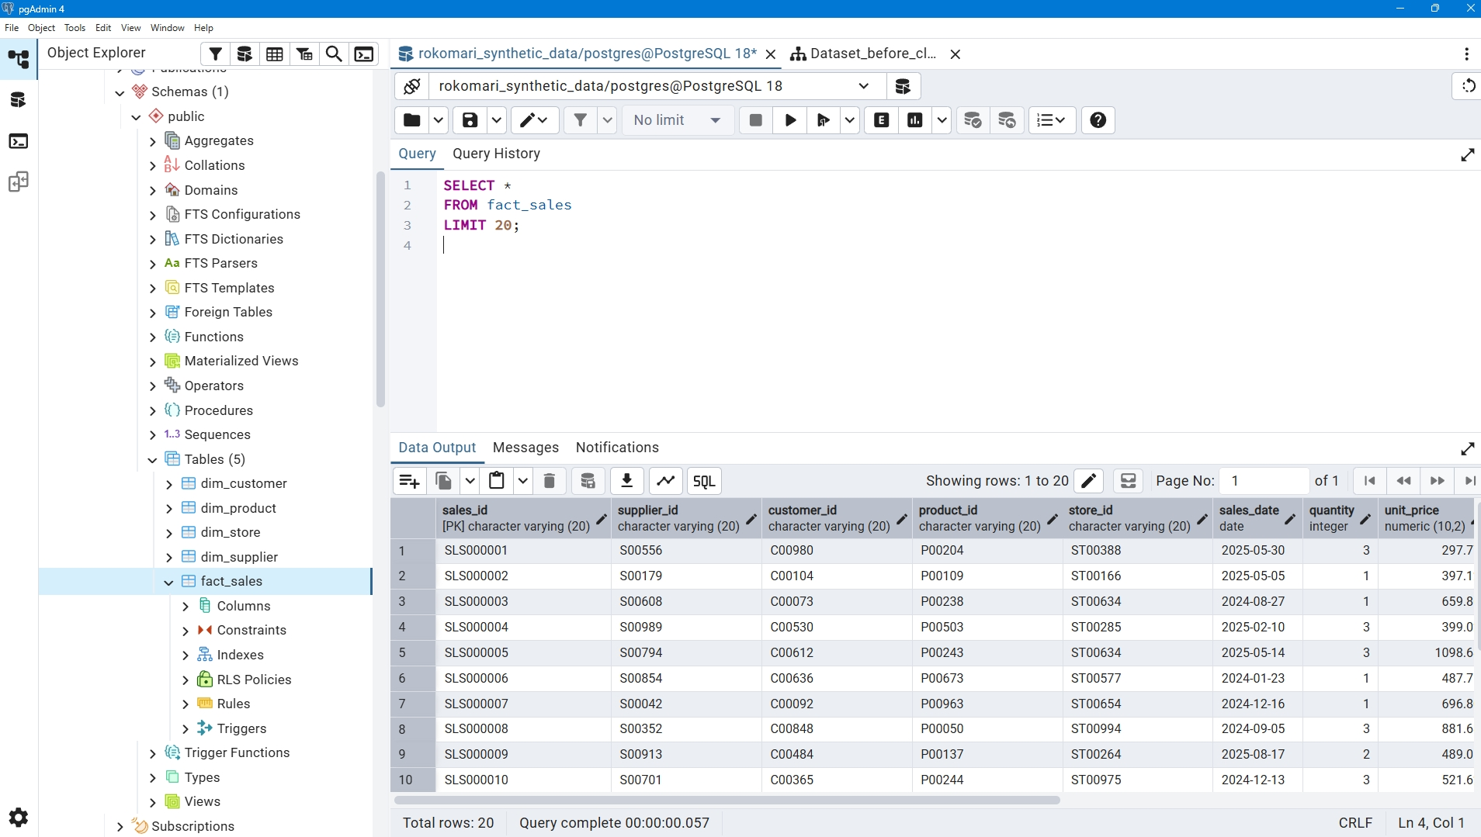
fact_sales — CREATE TABLE
POSTGRESQL IMPLEMENTATION
PostgreSQL database creation
CREATE TABLE fact_sales (
sales_id VARCHAR(20) PRIMARY KEY,
supplier_id VARCHAR(20),
customer_id VARCHAR(20),
product_id VARCHAR(20),
store_id VARCHAR(20),
sales_date DATE,
quantity INT,
unit_price NUMERIC(10,2),
discount NUMERIC(5,2),
total_amount NUMERIC(12,2),
payment_method TEXT,
sales_channel TEXT,
reader_group TEXT,
category TEXT,
CONSTRAINT fk_supplier
FOREIGN KEY (supplier_id)
REFERENCES dim_supplier(supplier_id),
CONSTRAINT fk_customer
FOREIGN KEY (customer_id)
REFERENCES dim_customer(customer_id),
CONSTRAINT fk_product
FOREIGN KEY (product_id)
REFERENCES dim_product(product_id),
CONSTRAINT fk_store
FOREIGN KEY (store_id)
REFERENCES dim_store(store_id)
);
1 Create Tables
2 Bulk Load via COPY
3 Validate Relationships
4-dimension tables and 1 fact table (fact_sales) with PK and FK constraints.
Import cleaned CSVs with COPY SQL query.
Confirm row counts & FK joins across all 5 tables.
RETAIL CUSTOMER BEHAVIOR & SALES ANALYTICS • ROKOMARI BOOK SHOP
05

Slide 5
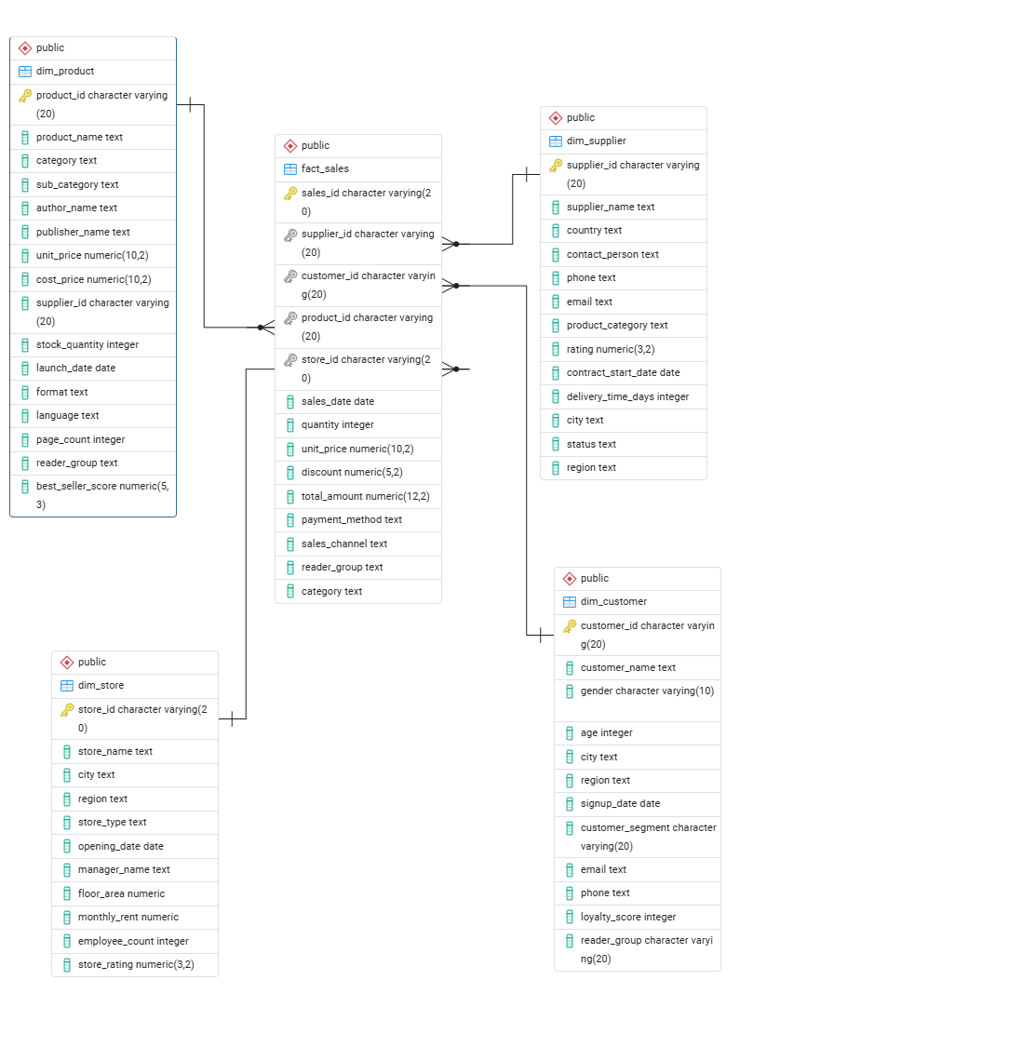
DATABASE DESIGN
Star Schema Architecture
Schema Highlights
fact_sales is the analytical core — quantity, price, discount, total amount, sales channel, reader group etc.
4 dimensions: dim_customer, dim_product, dim_store, dim_supplier.
Load the CSV dataset into the PostgreSQL database tables.Referential integrity enforced via foreign-key constraints
RETAIL CUSTOMER BEHAVIOR & SALES ANALYTICS • ROKOMARI BOOK SHOP
04

Slide 6





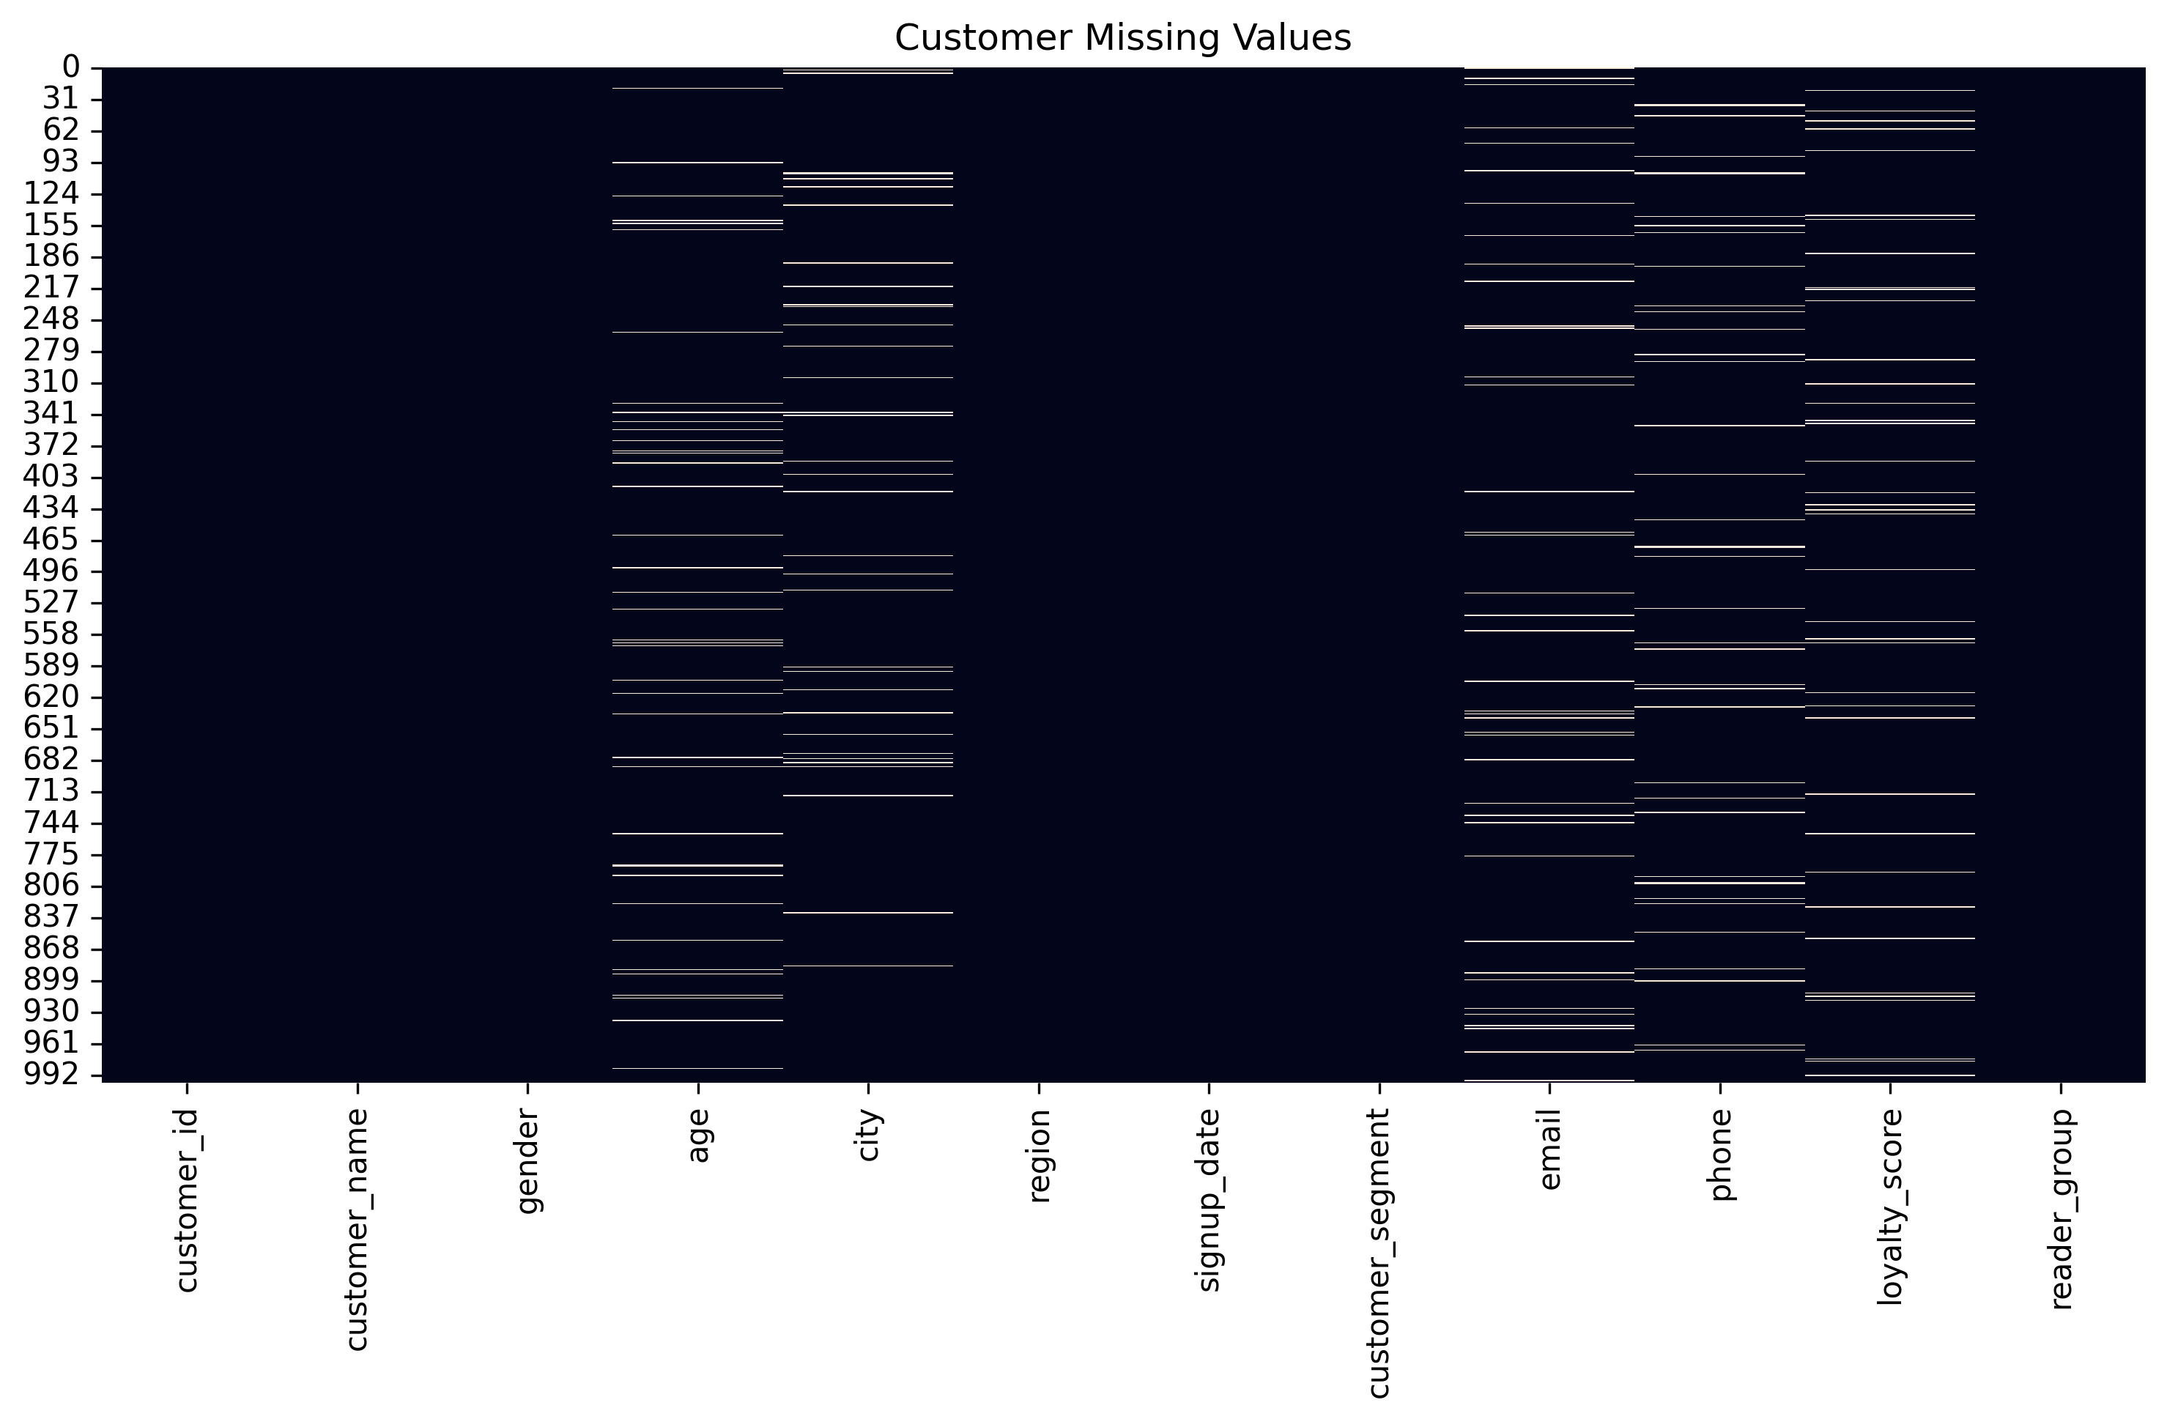
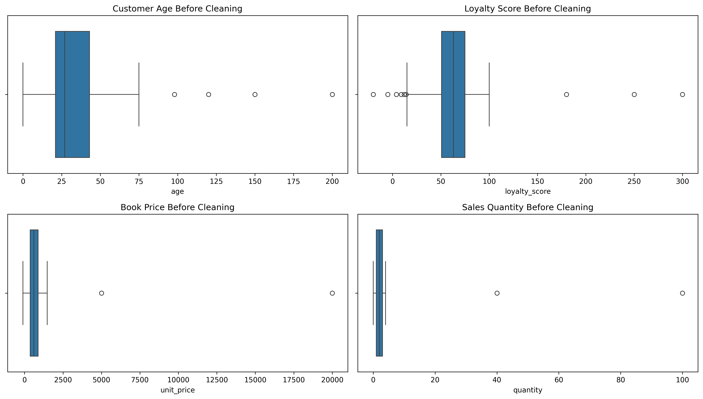
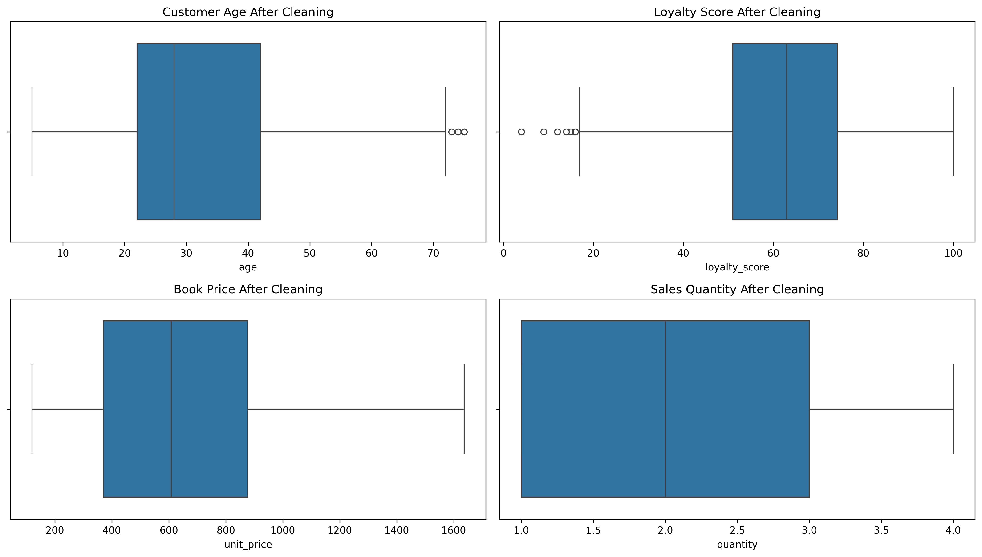
DATA PREPROCESSING
Six-Step Cleaning Pipeline in Jupiter Notebook
1. Missing Value
Audit
2. Invalid Value
Detection
3. Text
Standardization
4. KNN
Imputation
5. Outlier Capping
(IQR)
6. Duplicate
Removal
BEFORE — Missing Value Map (Customers)
BEFORE — Unrealistic outlier value
AFTER — Bounded, Realistic Distributions
06

Slide 7
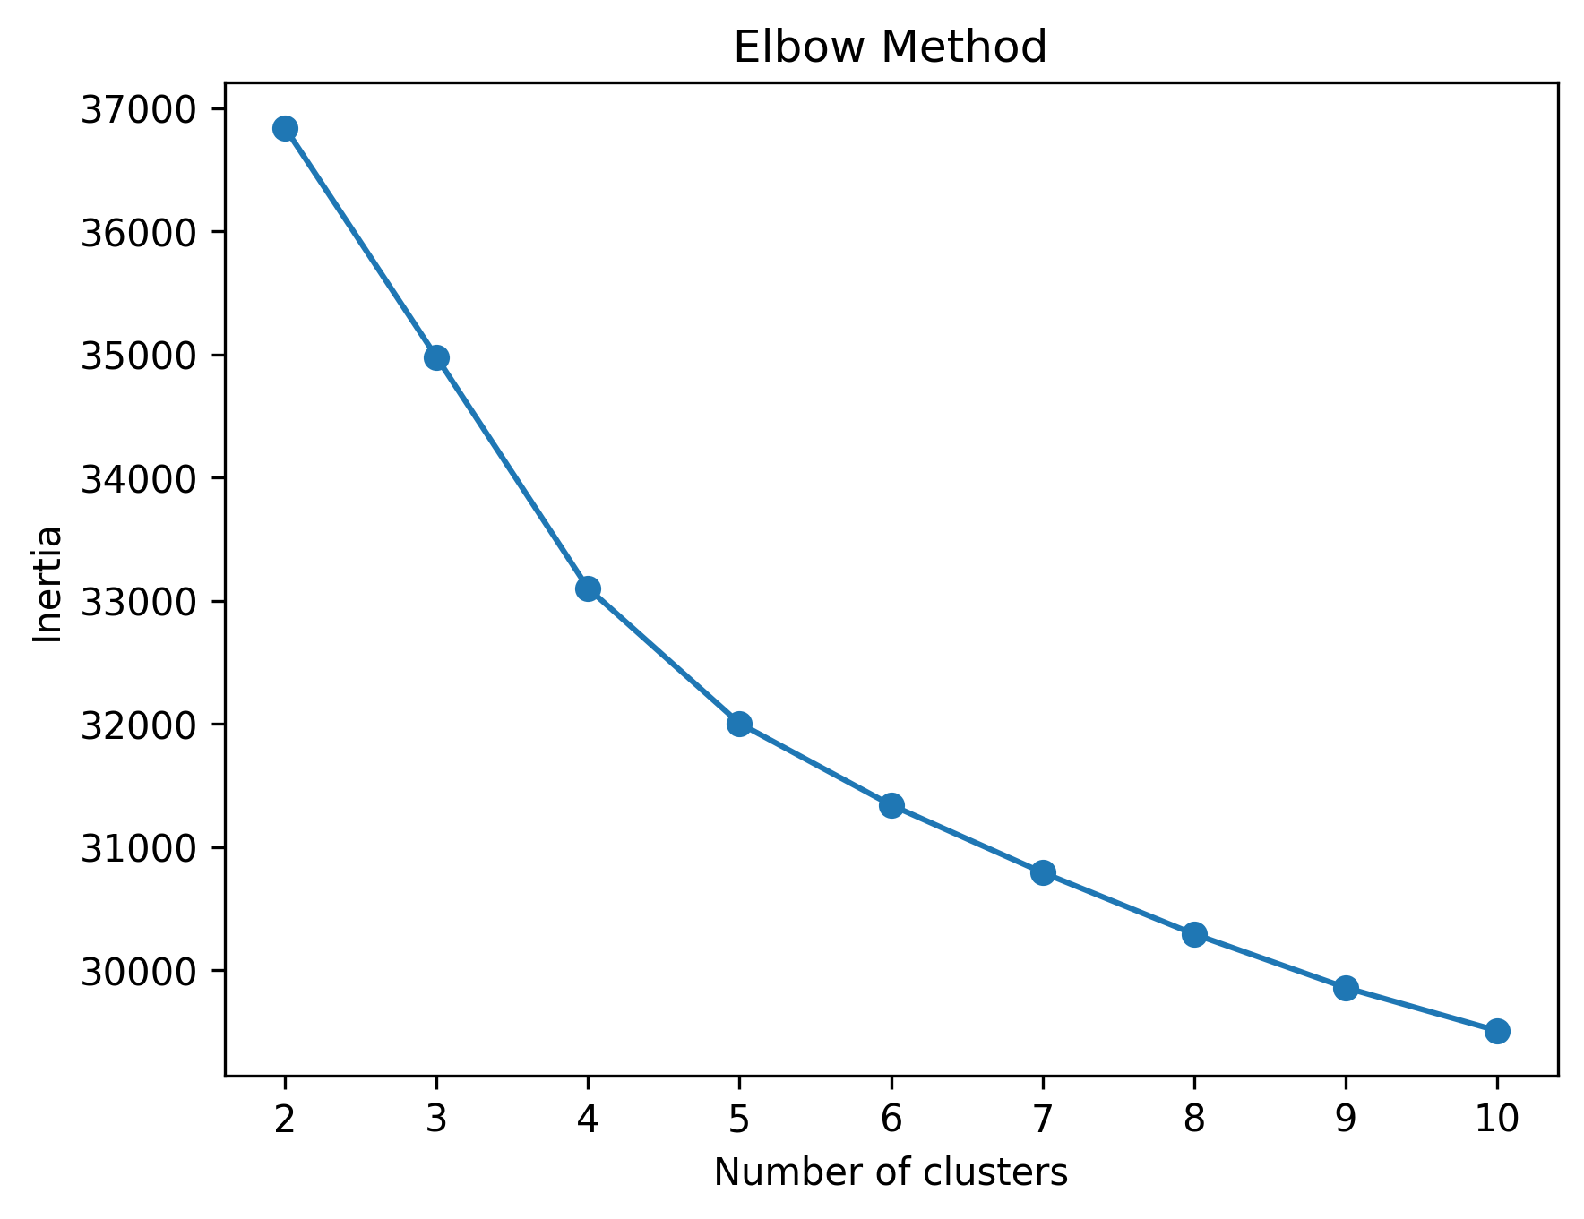
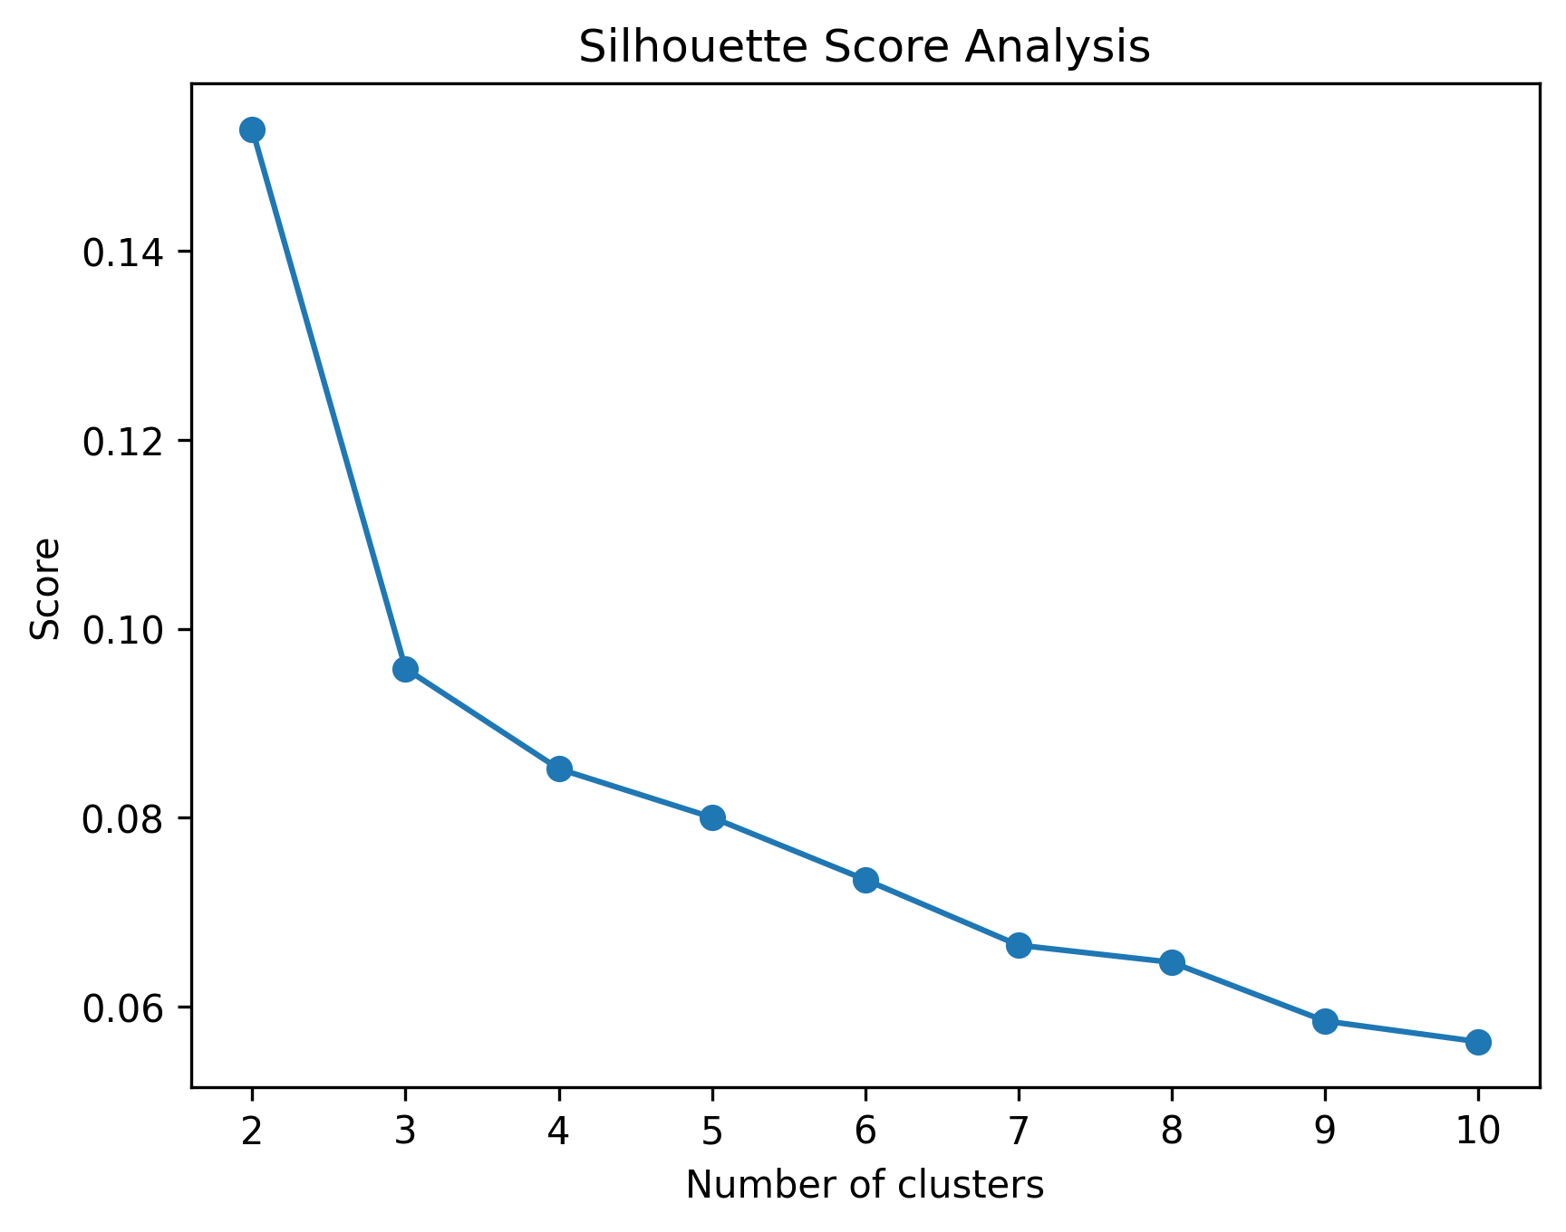
CLUSTERING APPROACH
Finding the Right Number of Segments (K-Means K=4)
Customers segmented on standardized behavioral & demographic features — age, loyalty score, spend, quantity, discount, reader group, format, channel and more.
Elbow Method
Silhouette Score Analysis
k = 4 | Silhouette Score = 0.082 → four behaviorally distinct customer segments selected
07

Slide 8
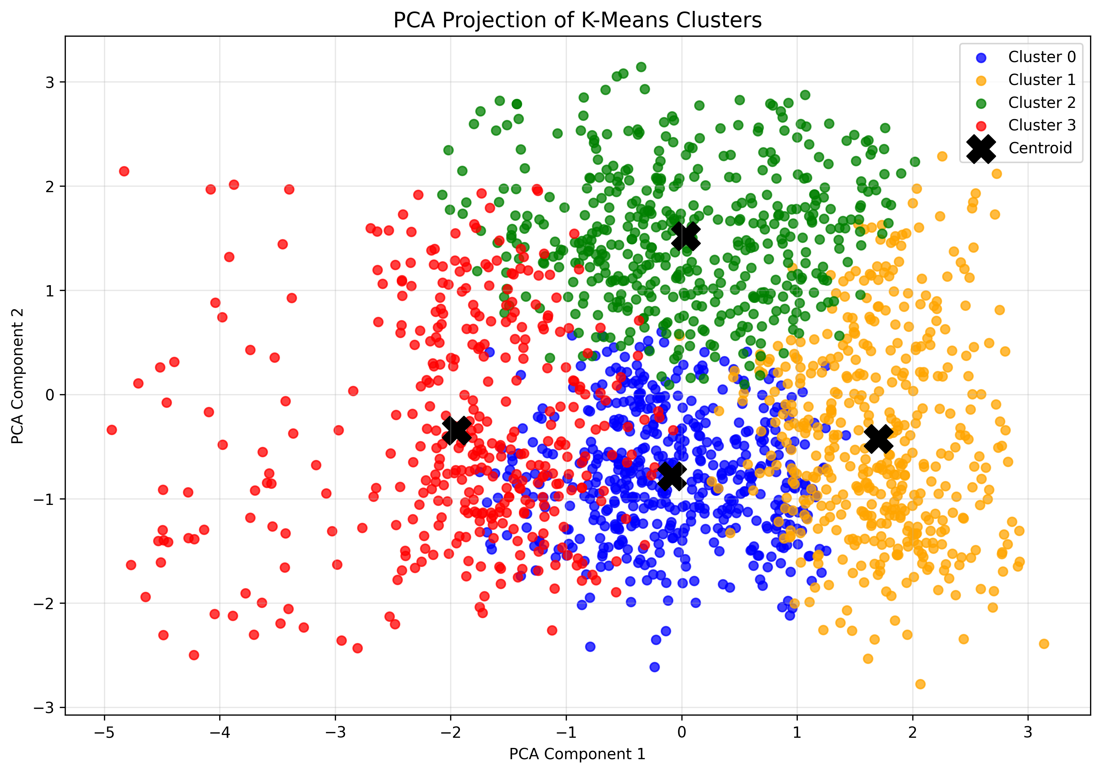
CUSTOMER SEGMENTATION
Cluster Profiles at a Glance
Metric | C0 | C1 | C2 | C3
Size | 507 | 450 | 475 | 381
Avg Spend (Tk) | 834 | 2,239 | 931 | 829
Avg Qty / Order | 1.7 | 3.2 | 1.9 | 1.5
Avg Age | 24.1 | 23.7 | 25.5 | 48.0
Top Group | Young | Young | Young | Prof.
Top Channel | In-Store | In-Store | Online | Online
Cluster 0 is high-volume, young demographic that prefers purchasing In-Store. Cluster 1 is the highest-value segment — 3x the spend & basket size of others. Cluster 3 is an older, Professional reader segment — a target for premium offers.
08

Slide 9
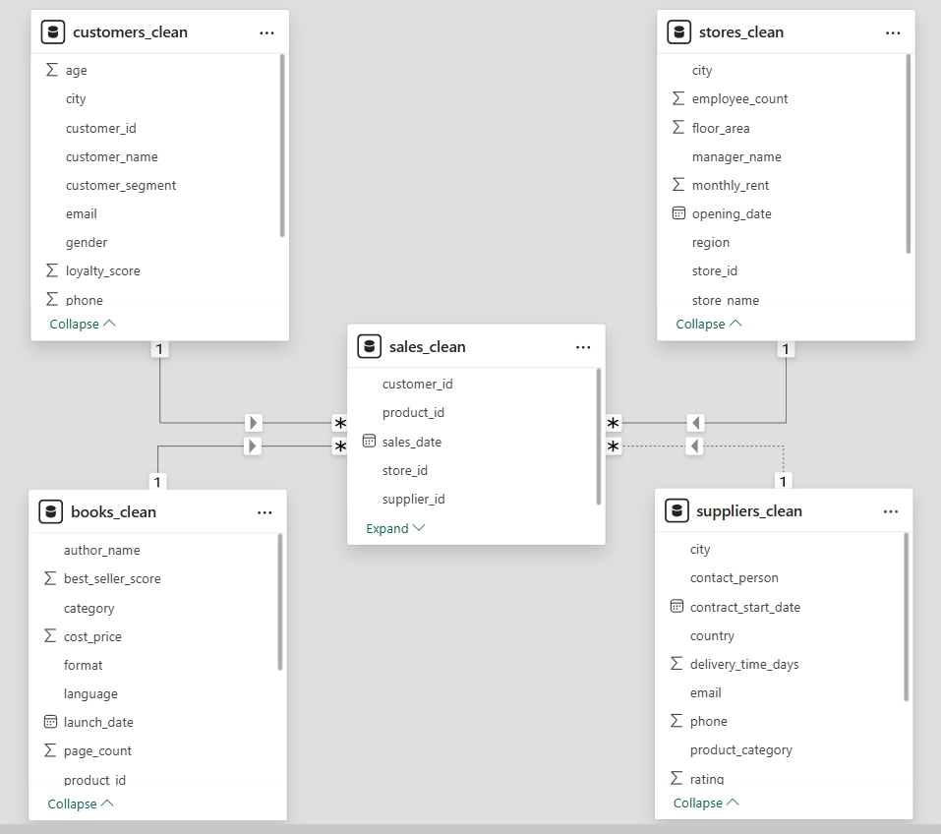
POWER BI DATA MODEL
Star Schema in Power BI
Model Structure
sales_clean is the central fact table — one row per transaction
4 dimensions radiate outward: customers, books, stores, suppliers
Every relationship is one-to-many, enabling slicers on any dimension
Keeps DAX measures simple and aggregation fast across visuals.
RETAIL CUSTOMER BEHAVIOR & SALES ANALYTICS • ROKOMARI BOOK SHOP
09

Slide 10
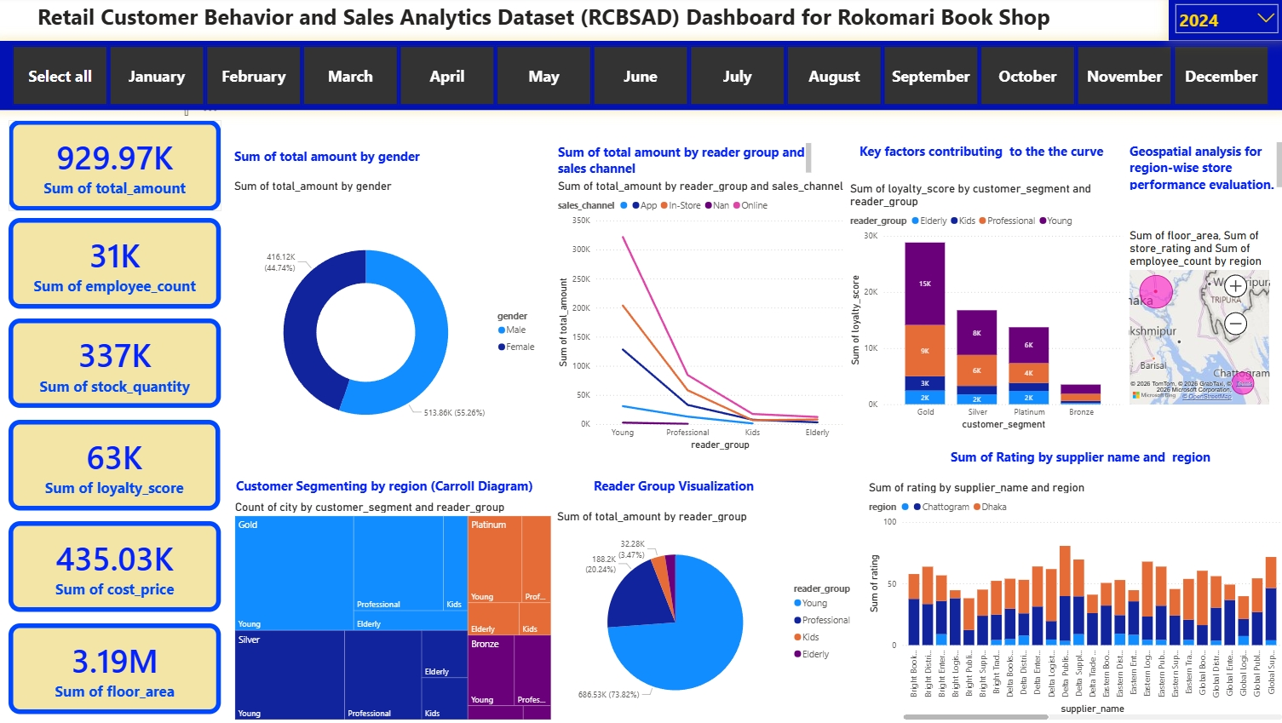
POWER BI DASHBOARD
An Interactive View of the Whole Business
10
KPIs, slicers, filters and drill-through visuals — built on the star-schema model for fast, interactive analysis.

Slide 11
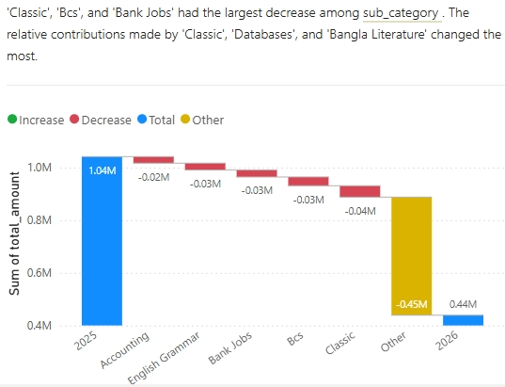
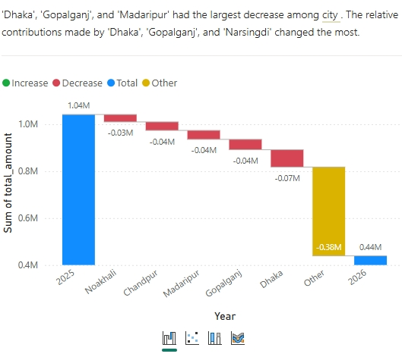
POWER BI DASHBOARD
Decomposition Views — What Drove the Decline?
Waterfall decomposition lets us to drill into what drives the year-over-year change in total sales — by book sub-category and by city.
By Book Sub-Category
By City
Classic, BCS & Bank Jobs sub-categories — and Dhaka, Gopalganj & Madaripur — show the steepest 2026 declines.
11

Slide 12
KEY INSIGHTS & CONCLUSION
What We Learned
73.8%
55 / 45
Tk 2,239
k = 4
of total sales driven by the
“Young” reader segment
revenue split between
female and male customers
avg. spend in Cluster 1 —
3x other segments
distinct behavioral customer
segments identified
CONCLUSION
A complete, reproducible pipeline: synthetic data → cleaning → PostgreSQL star schema → K-Means segmentation → interactive Power BI dashboard.
Enables Rokomari to target reader segments, prioritize high-value customers, optimize inventory, and address regional sales declines.
The clean, star-schema design is scalable — new stores, products or years of data can be added with minimal rework.
12

Slide 13
Thank You
GROUP 4 · INSIGHT ORBIT
Presented to Kh. Ehsanur Rahman — Data Science Faculty, UIU | MSCSE, Dept. of CSE

